Slide 1
Learn JavaScript with fun, build an UFO hunter game HTML and CSS Crash Course - CSS

Slide 2

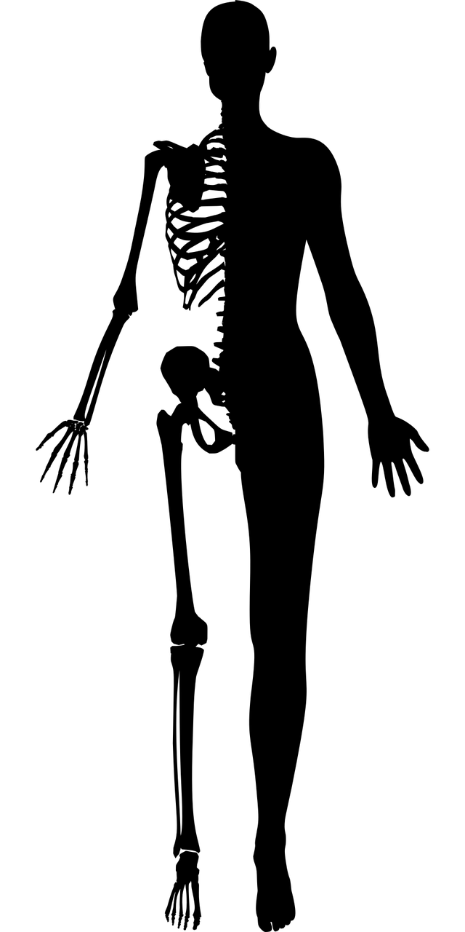

HTML, CSS and JavaScript
HTML
CSS
JavaScript
Structure
Styling, presentation
Functionality, behavior

Slide 3

CSS overview
Like HTML, CSS is not really a programming language. It is not a markup language either, it is a style sheet language. This means that it lets you apply styles selectively to elements in HTML documents.
declaration
selector
Selector: It selects the element(s) to be styled (in this case, <p> elements).
Declaration: Specifying which of the element's properties you want to style and how.
Property: The element's property which you want to style.
property
property value
Property value: The value of the element’s property which you want to style.

